Slide 1
Slough Insights
September 2024

Slide 2
About this pack…
This pack has been created to provide some insights on Slough, our residents and the borough’s economy. It draws upon data from the 2021 Census and other key sources of information.
It is intended to be viewed as a first point of reference, to provide high-level insights on key challenges and key strengths for the town, and is designed as a tool to support the council in the development of our strategies and in making evidence-based decisions.
This pack should be used alongside other key sources of information, such as the Joint Strategic Needs Assessment (JSNA), equalities data, resident consultations, and other service-level sources of data.
In order to save room – data sources and definitions are in the ‘notes section’ of the slides, and links to our data sources can be found on the final slide.

Slide 3
Headlines
Slough has a diverse, young population.
Slough has pockets of severe deprivation.
Slough has high levels of overcrowding and the largest average household size in England and Wales.
Slough’s economically active population has increased in 2023 compared to the 2021 census.
Slough has high proportions of children in low-income families and pensioners in poverty.
There is a gap in weekly income between Slough residents and those who commute into Slough for work. However, this gap has decreased from 2022 to 2023.
There are higher levels of crime compared to the TVP average, including violent crime.
Slough has generally good levels of educational attainment but is below the national average for post-16 education and qualifications.

Slide 4
Contents (1)
Population slides 6-29 | Population size Population density Age Country of birth Ethnicity National identity | Language Religion Sexual orientation & gender identity Deprivation | Health inequalities Premature mortality General health General wellbeing Disability Unpaid care
Built & Natural Environment slides 32-40 | Household size Overcrowding Tenure Accommodation & affordability | Housing benefit, central heating & household car use | Environmental & housing deprivation measures Green spaces & air quality
Work & Labour Market slides 41-48 | Economic activity Unemployment & job density Employment deprivation | Industry Occupation | Vacancies Productivity & business
Vulnerability slides 49-56 | Family income, fuel poverty & loneliness Universal Credit | Homelessness Support Vulnerable children | Adult needs (aged 18-64) Adult needs (aged 65 and over)

Slide 5
Contents (2)
Income slides 57-60 | Weekly earnings Income deprivation
Crime slides 61-62 | Crime rates
Education slides 63-71 | Early Years Foundation Stage (EYFS) Key Stage 2 Key Stage 4 Post-16 Qualifications SEND EHC plans SEN support & EHC plan attainment

Slide 6
Population

Slide 7

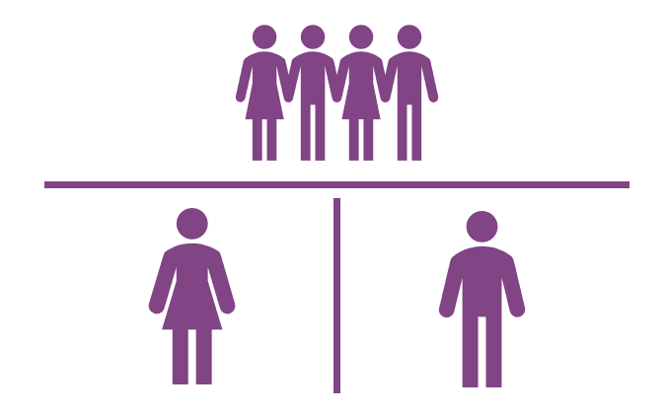

Population - Residents & Households
2022 ONS Population Estimates
The ONS estimates Slough’s population in 2022 to be 159,182.
2021 Census
In the 2021 Census, Slough’s population was 158,500, an increase of 13% from the 2011 census.
In 2021, 52,423 households in Slough contained at least one person – a growth of only 3.3% on 2011, compared to 6.1% in England and Wales.
Slough has a mean household size of 3 people per household. This is the largest mean household size in England and Wales. The mean for England and Wales is 2.4.
Frimley ICS
It is worth noting that Frimley ICS data shows Slough’s population to be 169,061* in September 2024. However, the ONS estimate is usually used as the official population statistic for Slough and is used as the denominator for other ONS statistics in this pack. Therefore, we recommend using the ONS population estimate.
Slough population: 159,182
Females
80,258
(50.4%)
Males
78,924
(49.6%)
52,423 Households
3 people per Household
Notes:
Sources:
ONS mid-year population estimates for 2022 (published Nov 2023)
Census 2021 and 2011.
Frimley ICS Connected Care System Insights, September 2024.
*Frimley ICS data excludes patients who opted out of secondary uses for their data, so the true population will be slightly higher.

Slide 8
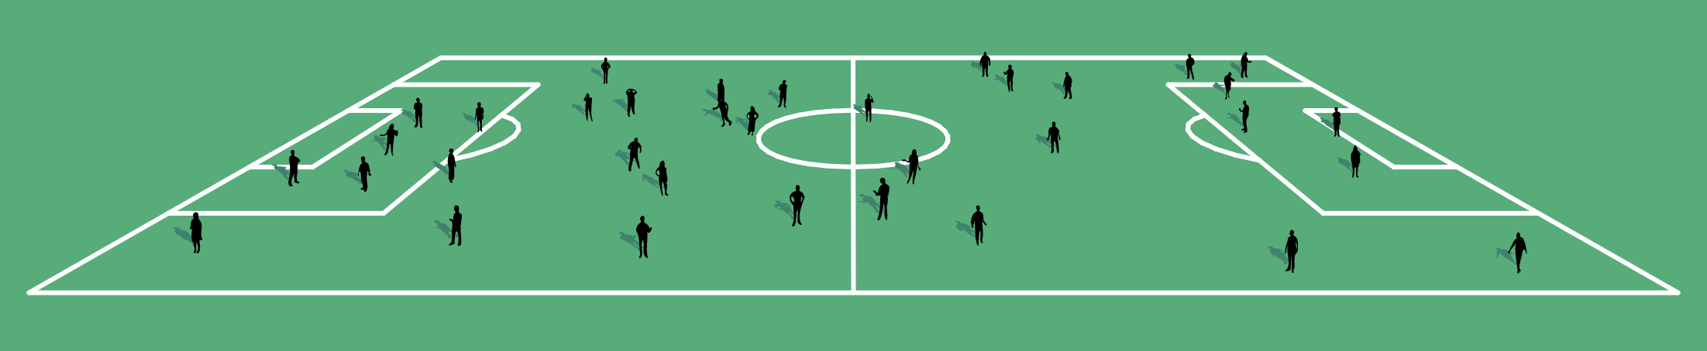
Population - Density
Slough is the third most densely populated LA in the South East, with 4,871 usual residents per square kilometre (48.7 per hectare compared to 45.8 in 2011, South East: 4.87, England: 4.34).
This is the equivalent of around 35 people living on each football pitch-sized area of land, compared to an average of just 3 across England.
Slough is the fifth most densely populated Local Authority outside of London.
Slough has the third smallest population within Berkshire but is the most densely populated.
Notes:
Sources: Census 2021 and 2011.

Slide 9
Population - Age
25% of Slough’s residents are aged 0-15, 65.1% are aged 16-64, and 9.9% are aged 65 or over.
Slough’s average age is 35, compared to 41 for the South East and England.
Slough has the second largest proportion of children aged 15 or under in England and Wales, behind only Barking and Dagenham.
Age Group | Slough Number | Slough % | England %
0-15 | 39,800 | 25.0% | 18.5%
16-64 | 103,600 | 65.1% | 62.9%
65+ | 15,700 | 9.9% | 18.6%
Notes:
Sources: ONS mid-year population estimates for 2022 (published Nov 2023).

Slide 10
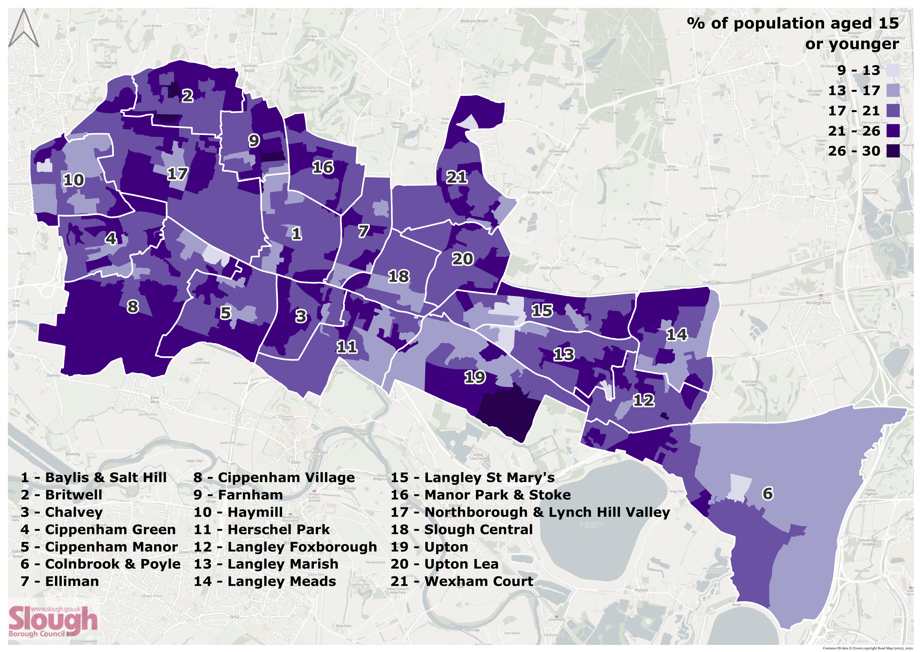
Population – Children aged 15 or under
This map shows the percentage of the population that was aged 15 and under across Slough in the 2021 census.
There are pockets of particularly high percentages of children aged 15 and under (darkest purple, 26-30%) in Britwell, Farnham, and Upton.
Notes:
Sources: Census 2021.
The map uses Lower-tier Super Output Areas (LSOAs), which comprise between 400 and 1,200 households and have a usual resident population between 1,000 and 3,000 persons.

Slide 11
Population – Country of Birth (Broad)
56% of Slough’s population were born in the UK, 24.3% were born in the Middle East and Asia, and 12.0% were born in the EU.
Broad Country of Birth: Number of Slough Residents | 2021 | 2011 | Change
United Kingdom | 88,806 | 85,553 | +4%
Middle East and Asia | 38,461 | 28,304 | +36%
European Union | 19,042 | 12,996 | +47%
Africa | 8,662 | 9,179 | -6%
The Americas and the Caribbean | 1,633 | 1,886 | -13%
Non-EU European Countries | 1,454 | 728 | +100%
Antarctica, Oceania, and Other | 161 | 195 | -17%
Notes:
Sources: Census 2021 and 2011.

Slide 12
Population – Country of Birth (Detailed)
After England, the most selected countries
of birth for residents in Slough were:
  India
  Pakistan
  Poland
  Romania
  Kenya
10.5% of Slough’s population arrived in the
UK aged 0-15, 33.2% arrived aged 16-64,
and 0.3% arrived aged 65 or over.
64.1% of the migrant population in Slough have resided in the UK for 10 or more years, 15.6% for 5-9 years, 11.3% for 2-4 years, and 9% for less than 2 years.
Broad Country of Birth (2021) | Detailed Country of Birth | Slough Number | Slough %
United Kingdom | England | 87,350 | 55.1%
Middle East and Asia | India | 17,107 | 10.8%
Middle East and Asia | Pakistan | 14,418 | 9.1%
European Union | Poland | 8,912 | 5.6%
European Union | Romania | 3,551 | 2.2%
Africa | Kenya | 1,940 | 1.2%
Middle East and Asia | Sri Lanka | 1,385 | 0.9%
Non-EU Europe | Other Europe | 1,384 | 0.9%
Africa | Somalia | 1,336 | 0.8%
Africa | Other South and Eastern Africa | 1,228 | 0.8%
Notes:
Source: Census 2021.

Slide 13
Population – Ethnicity (1)
46.7% of Slough’s population are from Asian ethnic groups and 36.0% are from White ethnic groups.
Broad Ethnic Groups: Number of Slough Residents | 2021 | 2011 | Change
Asian ethnic groups | 74,093 | 55,697 | +33%
White ethnic groups | 57,134 | 64,053 | -11%
Black ethnic groups | 11,992 | 12,115 | -1%
Other ethnic groups | 7,144 | 2,628 | +172%
Mixed ethnic groups | 6,311 | 4,758 | +33%
Arab ethnic groups | 1,826 | 954 | +91%
Notes:
Sources: Census 2021 and 2011.

Slide 14
Population – Ethnicity (2)
Ten Largest (Detailed) Ethnic Groups in Slough in 2021 | No. Residents
White: English, Welsh, Scottish, Northern Irish or British | 38,093
Asian, Asian British or Asian Welsh: Pakistani or British Pakistani | 34,317
Asian, Asian British or Asian Welsh: Indian or British Indian | 30,209
White: Polish | 7,778
Other ethnic group: Sikh | 3,200
Black, Black British, Black Welsh of African background: African unspecified | 2,933
Black, Black British, Black Welsh or Caribbean background: Caribbean | 2,769
White: European Mixed | 2,363
White: Romanian | 2,258
Mixed or Multiple ethnic groups: White and Asian (unspecified) | 1,945
Notes:
Source: Census 2021.
Data Quality Info: There have been many changes to the detailed ethnic group categories used since the 2011 census, including the addition of several new categories for the 2021 census (bringing the total to 287 groups). This change is due to the new “search-as-you-type” function introduced for the 2021 census which made it easier for people to self-identify. These changes to the categories make it difficult to make direct and accurate comparisons between groups from the two censuses. Therefore, only the 2021 data is presented here.

Slide 15
Population – National identity
23% of Slough’s population identify as a non-UK identity only
  7,767 people (4.9%) identify as Polish only
  6,866 (4.3%) identify as Indian only
  3,828 (2.4%) identify as Pakistani only
  3,295 (2.1%) identify as Romanian only
National Identity: Number of Slough Residents | 2021 | 2011 | Change
British only identity¹ | 96373 | 49093 | +96%¹
English only identity¹ | 11000 | 47868 | -77%¹
English and British only identity | 8248 | 6416 | +29%
Scottish or Scottish & British | 402 | 778 | -48%
Welsh or Welsh & British | 274 | 634 | -57%
Northern Irish or Northern Irish & British | 125 | 199 | -37%
Cornish or Cornish & British | 9 | 11 | -18%
Any other combination of only UK identities | 98 | 223 | -56%
Non-UK identity only | 36460 | 32490 | +12%
Non-UK identity and at least one UK identity | 5509 | 2493 | +121%
Notes:
Sources: Census 2021 and 2011.
¹Data Quality Info: The ONS has noted that while the increase in the number of residents describing their national identity as "British" and the decrease in the number describing their identity as "English" may partly reflect true change, it is most likely to be a result of the changes to the question structure where "British" became the first response option listed in 2021 for England only.

Slide 16
Population - Language
72.7% of Slough’s population aged 3 and over speak English as their main language (England: 90.8%).
68 people in Slough use a Sign Language as their main language (57 use BSL).
Of those that did not speak English as their main language in Slough, 42.8% can speak English very well, which is an increase of 34% from 2011.
Main Language: Number of Slough Residents | 2021 | 2011 | Change
English | 110,212 | 96,508 | +14%
Panjabi | 9,527 | 8,247 | +16%
Polish | 7,724 | 8,249 | -6%
Urdu | 6,497 | 6,568 | -1%
Romanian | 3,275 | 401 | +717%
Tamil | 1,224 | 860 | +42%
Hindi | 1,148 | 825 | +39%
Telugu | 1,066 | 275 | +288%
Arabic | 983 | 703 | +40%
Somali | 772 | 938 | -18%
Notes:
Sources: Census 2021 and 2011.
This data only applies to residents aged 3 or over.

Slide 17
Population - Religion
The number of Christians in Slough has decreased by 12.2% since 2011, while the number of Muslims has increased by 42.9% and the number of Sikhs has increased by 20.8%.
Slough has the 11th fewest people nationally who stated they have no religion (13.1% of Slough’s population, compared to 36.7% for England).
Religion: Number of Slough Residents | 2021 | 2011 | Change
Christian | 50,664 | 57,726 | -12%
Muslim | 46,661 | 32,655 | 43%
No religion | 20,726 | 17,024 | 22%
Sikh | 17,985 | 14,889 | 21%
Hindu | 12,343 | 8,643 | 43%
Not answered | 8,544 | 7,956 | 7%
Buddhist | 776 | 743 | 4%
Other religion | 716 | 482 | 49%
Jewish | 85 | 87 | -2%
Notes:
Sources: Census 2021 and 2011.

Slide 18
Population - Sexual orientation & gender identity
1.9% of Slough’s population identified as an LGB+ orientation (lower than the England average of 3.2%).
0.9% of Slough’s population identified as a different gender to their sex registered at birth (same as the England average).
Sexual Orientation (2021) | Slough Number | Slough % | England %
Straight or Heterosexual | 104,943 | 88.2% | 89.4%
LGB+ orientation (total) | 2,313 | 1.9% | 3.2%
Gay or Lesbian | 806 | 0.7% | 1.5%
Bisexual | 1,095 | 0.9% | 1.3%
Pansexual | 335 | 0.3% | 0.2%
Asexual | 29 | 0.0% | 0.1%
Queer | 7 | 0.0% | 0.0%
All other sexual orientations | 41 | 0.0% | 0.0%
Not answered | 11,677 | 9.8% | 7.5%
Gender Identity (2021) | Slough Number | Slough % | England %
Gender identity the same as sex registered at birth | 107,503 | 90.4% | 93.5%
Gender identity different from sex registered at birth (total) | 1,081 | 0.9% | 0.9%
Gender identity different from sex registered at birth but no specific identity given¹ | 633 | 0.5% | 0.2%
Trans woman | 186 | 0.2% | 0.1%
Trans man | 206 | 0.2% | 0.1%
Non-binary | 25 | 0.0% | 0.1%
All other gender identities | 31 | 0.0% | 0.0%
Not answered | 10,351 | 8.7% | 6.0%
Notes:
Source: Census 2021.
Sexual Orientation
People were asked “Which of the following best describes your sexual orientation?”. The different sexual orientations that people could choose from included:
straight or heterosexual
gay or lesbian
bisexual
other sexual orientation
If they selected “Other sexual orientation”, they were asked to write in the sexual orientation with which they identified.
ONS Glossary
Sexual orientation: Sexual orientation is an umbrella term covering sexual identity, attraction, and behaviour. For an individual respondent, these may not be the same. For example, someone in an opposite-sex relationship may also experience same-sex attraction, and vice versa. This means the statistics should be interpreted purely as showing how people responded to the question, rather than being about whom they are attracted to or their actual relationships.
The ONS did not provide glossary entries for individual sexual orientation categories because individual respondents may have differing perspectives on the exact meaning.
Gender Identity
People were asked “Is the gender you identify with the same as your sex registered at birth?”, and had the option of selecting either “Yes” or “No”. If they selected “No”, they had the option to write in their specific gender identity.
¹Many people who selected that their gender identity is different from their sex registered at birth did not write in a specific identity. This was the same nationally, not just in Slough.
ONS Glossary
Gender identity: Gender identity refers to a person’s sense of their own gender, whether male, female or another category such as non-binary. This may or may not be the same as their sex registered at birth.
Gender identity different from sex registered at birth but no specific identity given: These are people who answered “No” to the question “Is the gender you identify with the same as your sex registered at birth?” but did not write in a gender identity.
Non-binary: Someone who is non-binary does not identify with the binary categories of man and woman. In these results the category includes people who identified with the specific term “non-binary” or variants thereon. However, those who used other terms to describe an identity which was neither specifically man nor woman have been classed in “All other gender identities”.
Trans man: A trans man is someone who was registered female at birth, but now identifies as a man.
Trans woman: A trans woman is someone who was registered male at birth, but now identifies as a woman.

Slide 19
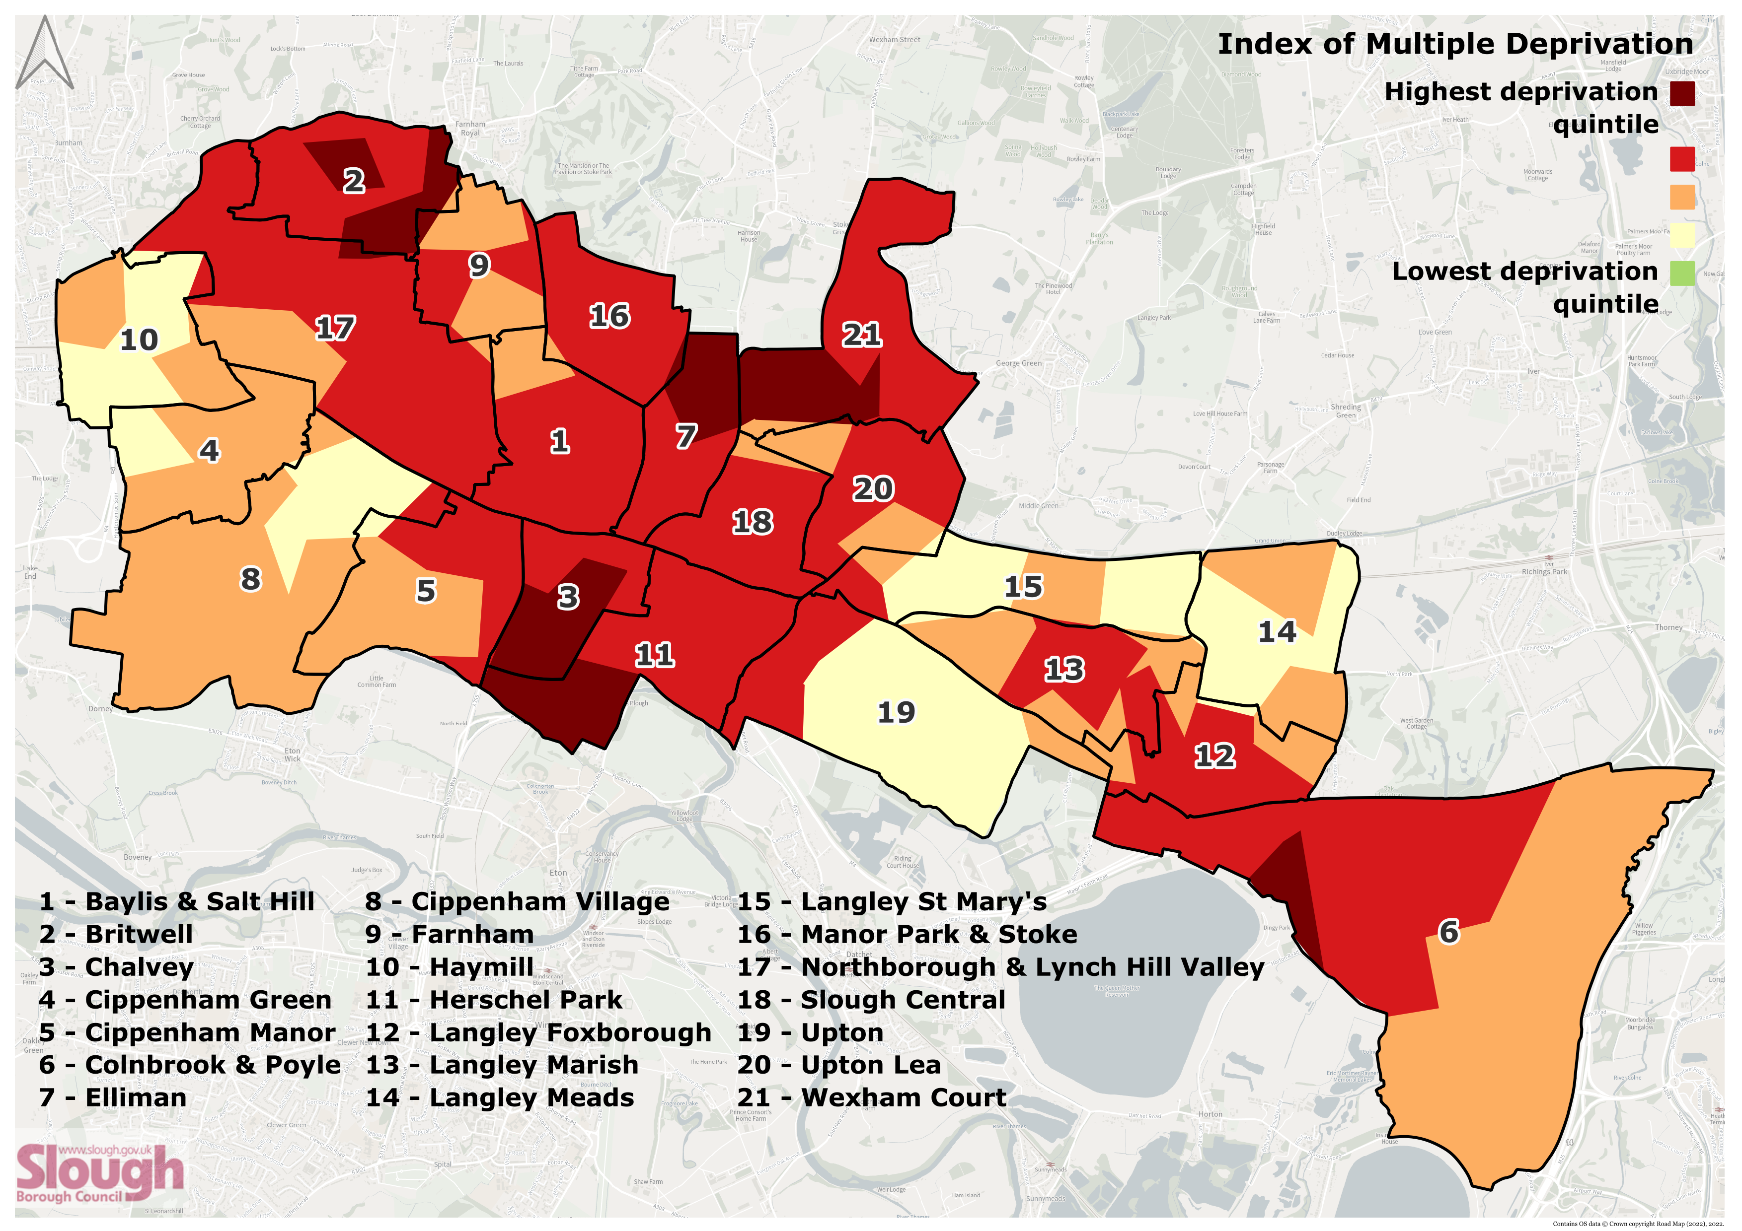
Population – Deprivation (1)
Slough is more deprived than the England average on the 2019 Index of Multiple Deprivation (IMD).
71% of Slough’s Lower-tier Super Output Areas (LSOAs) fall below the national average of the IMD.
There are particularly severe pockets of deprivation in Britwell, Chalvey, Herschel Park, Elliman, Wexham Court, and Colnbrook & Poyle.
Notes:
Source: Indices of Deprivation, 2019.
The map uses Lower-tier Super Output Areas (LSOAs), which comprise between 400 and 1,200 households and have a usual resident population between 1,000 and 3,000 persons.

Slide 20
Population – Deprivation (2)
57.7% of households in Slough (30,240 households) are deprived in one or more dimension in the 2021 census (England: 51.6%). The four dimensions of deprivation from the census are education, employment, health, and housing.
The total number of deprived households has decreased by 8% from 2011 (when it was 65.1%).
The number of households deprived in one dimension has increased by 4%, but there has been a 24% decrease in households deprived in two or more dimensions and a 25% increase in households that are not deprived in any dimension.
Household Deprivation: Number of Slough Households | 2021 | 2011 | Change
Household is not deprived in any dimension | 17,733 | 22,184 | +25%
Household is deprived in one dimension | 18,437 | 19,176 | +4%
Household is deprived in two dimensions | 11,077 | 8,603 | -22%
Household is deprived in three dimensions | 3,156 | 2,293 | -27%
Household is deprived in four dimensions | 363 | 168 | -54%
Notes:
Sources: Census 2021 and 2011.
The household deprivation dimensions:
Education - A household is classified as deprived in the education dimension if no one has at least level 2 education and no one aged 16 to 18 years is a full-time student.
Employment - A household is classified as deprived in the employment dimension if any member, not a full-time student, is either unemployed or economically inactive due to long-term sickness or disability.
Health - A household is classified as deprived in the health dimension if any person in the household has general health that is bad or very bad or is identified as disabled. People who have assessed their day-to-day activities as limited by long-term physical or mental health conditions or illnesses are considered disabled. This definition of a disabled person meets the harmonised standard for measuring disability and is in line with the Equality Act (2010).
Housing - A household is classified as deprived in the housing dimension if the household's accommodation is either overcrowded, in a shared dwelling, or has no central heating.

Slide 21
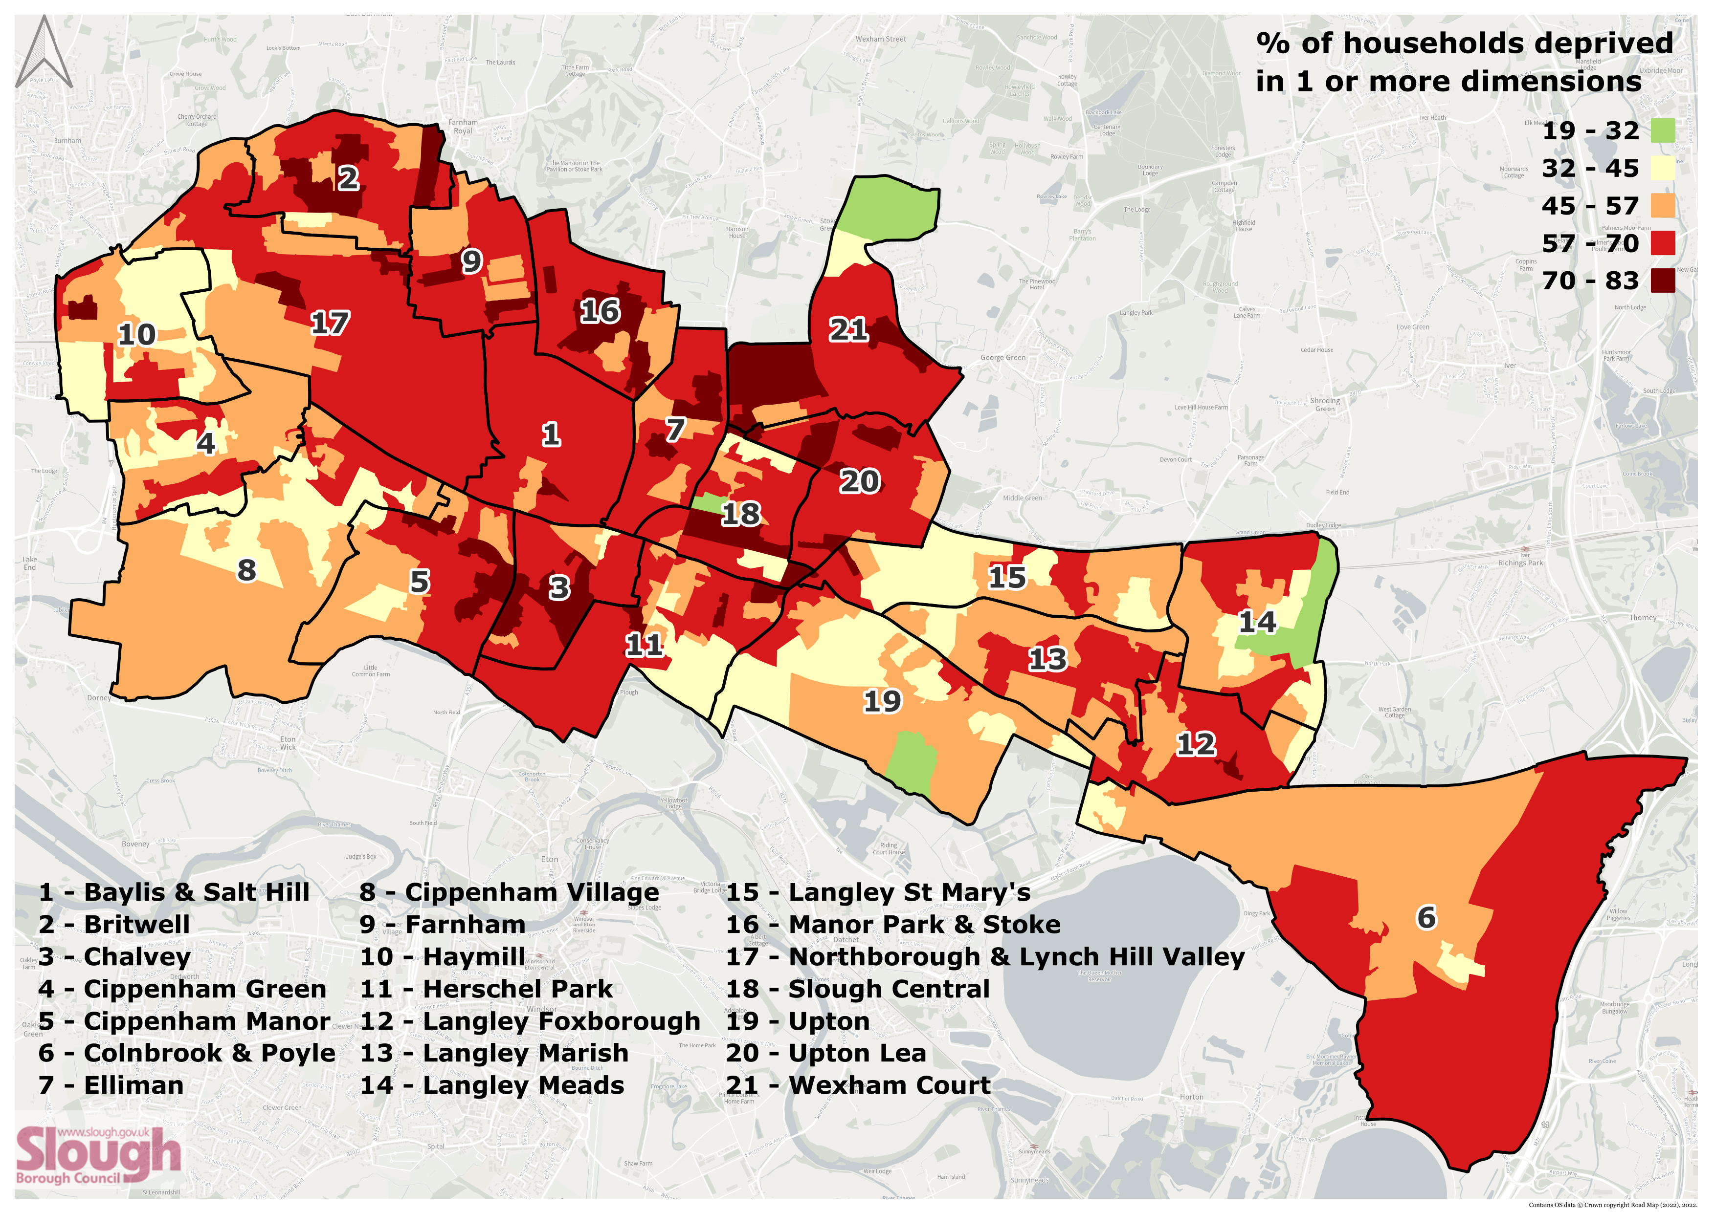
Population – Deprivation (3)
This map shows the percentage of households that are deprived in one or more dimension in the 2021 census.
The red and dark red represent areas where 57% or more households are deprived in one or more dimension.
The four dimensions are: education, employment, health, and housing.
Notes:
Sources: Census 2021.
The map uses Lower-tier Super Output Areas (LSOAs), which comprise between 400 and 1,200 households and have a usual resident population between 1,000 and 3,000 persons.
The household deprivation dimensions:
Education - A household is classified as deprived in the education dimension if no one has at least level 2 education and no one aged 16 to 18 years is a full-time student.
Employment - A household is classified as deprived in the employment dimension if any member, not a full-time student, is either unemployed or economically inactive due to long-term sickness or disability.
Health - A household is classified as deprived in the health dimension if any person in the household has general health that is bad or very bad or is identified as disabled. People who have assessed their day-to-day activities as limited by long-term physical or mental health conditions or illnesses are considered disabled. This definition of a disabled person meets the harmonised standard for measuring disability and is in line with the Equality Act (2010).
Housing - A household is classified as deprived in the housing dimension if the household's accommodation is either overcrowded, in a shared dwelling, or has no central heating.

Slide 22

Health inequalities
Health measure | Slough | South East | England
Healthy life expectancy (M) | 58.1 | 65.5 | 63.1
Healthy life expectancy (F) | 60.3 | 65.9 | 63.9
Low birth weight: term babies (under 2,500g) | 4.4% | 2.4% | 2.8%
Year 6: prevalence of obesity (incl. severe obesity) | 27.4% | 22.7% | 31.7%
% 5-year-olds with experience of visually obvious dental decay | 34.9% | 21.2% | 23.7%
% physically active adults (150+ minutes activity per week) | 56.6% | 70.2% | 67.1%
Notes:
Source: OHID, Fingertips Public Health Data.
Healthy life expectancy at birth (Male and Female, All ages), 2018 – 20
Low birth weight of term babies (Persons, >=37 weeks gestational age at birth), 2021
Year 6: Prevalence of obesity (including severe obesity) (Persons, 10-11 yrs), 2022/23
Percentage 5-year-olds with experience of visually obvious dental decay, 2021/22
Percentage of physically active adults (Persons, 19+ yrs), 2022/23
Healthy life expectancy = The number of years a person can typically expect to live in full health without disabling illness or injury.

Slide 23
Premature mortality
Mortality Rate | Slough | South East | England
Infant mortality rate (deaths per 1k under 1 year) | 7.6 | 3.3 | 3.9
Mortality rate: causes considered preventable (deaths per 100k under 75) | 215.6 | 143.6 | 171.4
Mortality rate: all circulatory diseases (deaths per 100k under 75) | 104.5 | 62.6 | 76.0
Mortality rate: circulatory diseases considered preventable (deaths per 100k under 75) | 44.6 | 24.0 | 30.1
Mortality rate: liver disease (deaths per 100k under 75) | 27.2 | 17.6 | 21.2
Mortality rate: liver disease considered preventable (deaths per 100k under 75) | 24.8 | 15.7 | 18.7
Mortality rate: specified communicable diseases, including influenza (deaths per 100k, all ages) | 16.1 | 8.4 | 10.3
Winter mortality index | 9.5% | 8.6 | 8.1
Notes:
Source: OHID, Fingertips Public Health Data.
Infant mortality rate, 2020-22
Under 75 mortality rate: causes considered preventable (Persons per 100k <75 yrs), 2020-22
Under 75 mortality rate from all circulatory diseases (Persons per 100k <75 yrs), 2020-22
Under 75 mortality rate: circulatory diseases considered preventable (Persons per 100k <75 yrs), 2020-22
Under 75 mortality rate: liver disease (Persons per 100k), 2020-22
Under 75 mortality rate: liver disease considered preventable (Persons per 100k <75 yrs), 2020-22
Mortality rate: specified communicable diseases, including influenza (Persons per 100k <75 yrs), 2021
Winter mortality index (all ages), August 2021 – July 2022
Please note, the year ranges and how these rates are calculated/what is included have changed since the previous Insights Pack, so the two packs should not be compared directly for this slide.
Specified communicable diseases = certain infectious and parasitic diseases (classified by underlying cause of death recorded as ICD10 codes A00 to B99) and influenza (J09 to J11). Public Health Outcomes Framework - Data - OHID (phe.org.uk)
Winter Mortality Index = compares the number of deaths during the winter period with the average for the non-winter periods

Slide 24
Population - General health (1)
Over half of Slough’s population reported “very good” health in 2021. This proportion has increased since 2011.
Slough has a smaller proportion of residents reporting they have “very good” health than the England average and a slightly larger proportion of residents with “good” or “fair” health.
General Health (Non-standardised¹) (2021) | Slough Number | Slough %
Very good health | 81,941 | 51.7%
Good health | 53,816 | 34.0%
Fair health | 16,804 | 10.6%
Bad health | 4,625 | 2.9%
Very bad health | 1,314 | 0.8%
Notes:
Sources: Census 2021 and 2011.
Data Quality Info: Census 2021 was conducted during the coronavirus (COVID-19) pandemic. This may have influenced how people perceive and rate their health and therefore may have affected how people chose to respond.
¹Standardisation of the health data: This slide uses age-standardised proportions for the graph and non-standardised counts for the table. When comparing between time periods (i.e., 2011 and 2021) or geographical areas (i.e., Slough and England), the ONS recommends using the age-standardised proportions in the graph. Age-standardisation mathematically adjusts the data to have the same age structure as a “standard population”. This gives the two groups the same age distribution structure to allow for comparisons between the groups, represented as a percentage. This will allow for comparisons between the 2021 and 2011 census and between Slough and the England average. For more information on age-standardisation, please read: https://blog.ons.gov.uk/2023/01/19/age-standardising-data-what-does-this-mean-and-why-does-it-matter/

Slide 25
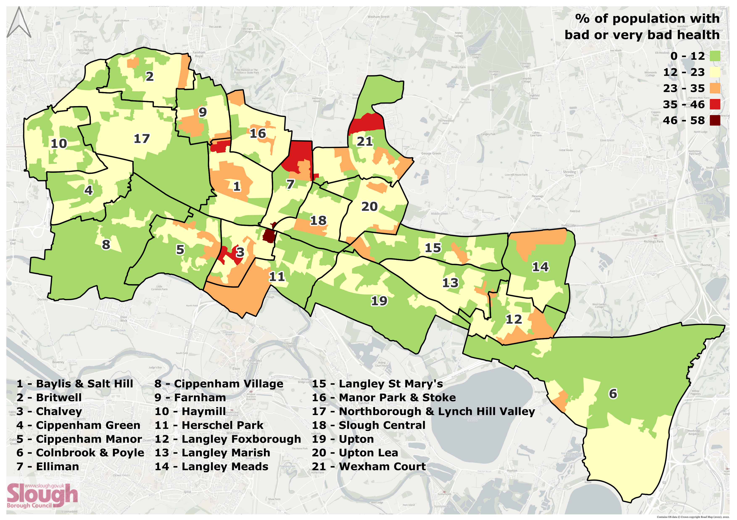
Population - General health (2)
This map shows the percentage of the population that self-reported they had bad or very bad health in the 2021 census.
The orange, red, and dark red represent areas where 23% or more reported bad or very bad health.
There are particularly large pockets of self-reported bad health in Baylis & Salt Hill, Chalvey, Elliman, and Wexham Court.
Notes:
Sources: Census 2021.
The map uses Lower-tier Super Output Areas (LSOAs), which comprise between 400 and 1,200 households and have a usual resident population between 1,000 and 3,000 persons.
Data Quality Info: Census 2021 was conducted during the coronavirus (COVID-19) pandemic. This may have influenced how people perceive and rate their health and therefore may have affected how people chose to respond.

Slide 26
Population - General wellbeing
Slough has similar average scores for anxiety and happiness to the South East and England averages, but has lower average scores for life satisfaction and feeling that the things they do are worthwhile.
Slough has smaller proportions of people with “very good” ratings for anxiety, happiness, life satisfaction, and feeling worthwhile than the England average, but has larger proportions of “good” ratings.
Slough has smaller proportions of “poor” ratings for anxiety and happiness than the England average, but slightly larger proportions for “poor” life satisfaction and feeling worthwhile.
Rating | Slough Anxiety | England Anxiety | Slough Happiness | England Happiness | Slough Life Satisfaction | England Life Satisfaction | Slough Worthwhile | England Worthwhile
Very Good | 31.0% | 35.7% | 31.8% | 32.3% | 16.0% | 26.0% | 25.0% | 32.6%
Good | 29.0% | 24.1% | 43.8% | 42.5% | 61.6% | 54.0% | 53.9% | 50.3%
Fair | 22.3% | 17.6% | 16.8% | 16.8% | 17.0% | 15.1% | 17.1% | 13.1%
Poor | 17.8% | 22.6% | 7.6% | 8.4% | 5.4% | 5.0% | 4.1% | 4.0%
Notes:
Source: Annual Population Survey 2020/21.
A high score for happiness, life satisfaction and worthwhile relates to positive wellbeing, while a high score for anxiety relates to poor wellbeing.
People were asked to rate on a 0-10 scale (0 is “not at all” and 10 is “completely”):
Overall, how satisfied are you with your life nowadays?
Overall, to what extent do you feel that the things you do in your life are worthwhile?
Overall, how happy did you feel yesterday?
Overall, how anxious did you feel yesterday?
These scores were then categorised as “very good”, “good”, “fair” or “poor” based on the following thresholds.
For happiness, life satisfaction, and worthwhile:
Very good = 9-10
Good = 7-8
Medium = 5-6
Poor = 0-4
For anxiety:
Very good = 0-1
Good = 2-3
Fair = 4-5
Poor = 6-10

Slide 27
Population – Disability (1)
Slough has a smaller proportion of disabled people than the England average.
The proportion of disabled people in Slough has decreased since 2011. However, it is important to note that the ONS has changed the way it identifies disabled people², which may have impacted the number of people identified as disabled in the data.
Disability (Non-standardised¹) (2021) | Slough Number | Slough %
Disabled: Total | 17,975 | 11.3%
Disabled: Day-to-day activities limited a lot | 7,880 | 5.0%
Disabled: Day-to-day activities limited a little | 10,095 | 6.4%
Not disabled/day-to-day activities not limited | 140,523 | 88.7%
Notes:
Sources: Census 2021 and 2011.
¹Standardisation of the disability data: This slide uses age-standardised proportions for the disability graph and non-standardised counts for the disability table. When comparing between time periods (i.e., 2011 and 2021) or geographical areas (i.e., Slough and England), the ONS recommends using the age-standardised proportions in the graph. Age-standardisation mathematically adjusts the data to have the same age structure as a “standard population”. This gives the two groups the same age distribution structure to allow for comparisons between the groups, represented as a percentage. This will allow for comparisons between the 2021 and 2011 census and between Slough and the England average. For more information on age-standardisation, please read: https://blog.ons.gov.uk/2023/01/19/age-standardising-data-what-does-this-mean-and-why-does-it-matter/
²Data Quality Info: Caution should be taken when making comparisons between 2011 and 2021 because of changes in question wording, response options, and the way the ONS identifies disabled people, which may have had an impact on the number of people identified as disabled. The question was changed in order to collect data that more closely aligned with the definition of disability in the Equality Act 2010. The Equality Act defines an individual as disabled if they have a physical or mental impairment that has a substantial and long-term negative effect on their ability to carry out normal day-to-day activities. Additionally, Census 2021 was undertaken during the coronavirus (COVID-19) pandemic, which may also have influenced how people perceive their health status and activity limitations and therefore may affect how people chose to respond.

Slide 28
Population – Disability (2)
Slough has a smaller proportion of households with disabled residents than the England average.
The number of households with one or more disabled people has decreased since 2011. However, it is important to note that the ONS has changed the way it identifies disabled people² since 2011, which may have impacted the number of people identified as disabled in the data.
Number of Disabled People in Slough Households¹ | 2021 | 2011 | Change
1 person disabled person in household | 10,810 | 11,388 | -5%
2 or more disabled people in household | 2,998 | 3,225 | -7%
Total households with 1 or more disabled people | 13,808 | 14,613 | -6%
Notes:
Sources: Census 2021 and 2011.
¹This data does not need to be age-standardised as it is uses the number of households, not residents, and therefore is not affected by differences in the age structure of populations.
²Data Quality Info: Caution should be taken when making comparisons between 2011 and 2021 because of changes in question wording, response options, and the way the ONS identifies disabled people, which may have had an impact on the number of people identified as disabled. The question was changed in order to collect data that more closely aligned with the definition of disability in the Equality Act 2010. The Equality Act defines an individual as disabled if they have a physical or mental impairment that has a substantial and long-term negative effect on their ability to carry out normal day-to-day activities. Additionally, Census 2021 was undertaken during the coronavirus (COVID-19) pandemic, which may also have influenced how people perceive their health status and activity limitations and therefore may affect how people chose to respond.

Slide 29
Population – Unpaid care
The proportion of residents (aged 5 and over) providing 1-19 hours of unpaid care a week has decreased since 2011, but the proportion of residents providing 20-49 hours has increased slightly.
Slough has a smaller proportion of residents providing 19 hours or less of unpaid care a week than the England average.
Unpaid Care (Non-standardised¹) (2021) | Slough Number | Slough %
Provides 1 to 19 hours unpaid care a week | 4,505 | 3.1%
Provides 20 to 49 hours unpaid care a week | 2,644 | 1.8%
Provides 50 or more hours unpaid care a week | 2,994 | 2.0%
Total number of unpaid carers | 10,143 | 6.9%
Notes:
Sources: Census 2021 and 2011.
Note: The census did not ask children under 5 if they provided unpaid care. This data is for only those aged 5 and over.
¹Standardisation of the unpaid care data: This slide uses age-standardised proportions for the graph and non-standardised counts for the table. When comparing between time periods (i.e., 2011 and 2021) or geographical areas (i.e., Slough and England), the ONS recommends using the age-standardised proportions in the graph. Age-standardisation mathematically adjusts the data to have the same age structure as a “standard population”. This gives the two groups the same age distribution structure to allow for comparisons between the groups, represented as a percentage. This will allow for comparisons between the 2021 and 2011 census and between Slough and the England average. For more information on age-standardisation, please read: https://blog.ons.gov.uk/2023/01/19/age-standardising-data-what-does-this-mean-and-why-does-it-matter/

Slide 30
Wider Determinants of Health

Slide 31
Wider determinants of health
Health & Wellbeing
Income
Built & natural environment
Work & Labour Market
Vulnerability
Crime
Education
The wider determinants of health are a diverse range of social, economic and environmental factors which influence people’s mental and physical health.
Relative contribution of determinants of health:
30% - Health Behaviours
40% - Socio-economic Factors
20% - Clinical Care
10% - Built Environment
The Public Health Outcomes Framework uses these six domains to map these determinants.
Public Health Outcomes Framework
Notes:
More information on the PHOF wider determinants of health can be found here: https://fingertips.phe.org.uk/profile/wider-determinants

Slide 32
Built & natural environment
Education
Work & Labour Market
Health & Wellbeing
Crime
Vulnerability
Income

Slide 33

Built & Natural Environment – Household size
There are 52,423 households in Slough.
Slough has the largest average household size in England and Wales at 3 people per household (England: 2.4).
There has been an increase of 49% in the number of households with 7 people and an increase of 92% in the number of households with 8 or more people.
There are now 2,078 households consisting of 7 or more people.
Notes:
Sources: Census 2021 and 2011.

Slide 34
Built & Natural Environment – Overcrowding (1)
15.8% of households in Slough are overcrowded (South East: 3.4%, England: 4.3%).
A home is considered overcrowded if it has fewer bedrooms than required for its occupants (an occupancy rating of -1 or less).
Slough has the fourth highest percentage of overcrowded houses in England and Wales, and the highest percentage outside of London.
The number of overcrowded households has increased by 29% since 2011.
Under-occupied
Overcrowded
Notes:
Sources: Census 2021 and 2011.
Occupancy Ratings
This is a measure of whether a home is overcrowded or under-occupied.
An occupancy rating of:
+1 or more implies that a household’s accommodation has more rooms than required (under-occupied)
0 suggests that a household’s accommodation has an ideal number of rooms
-1 or less implies that a household’s accommodation has fewer rooms than required (overcrowded)
The people who should have their own room according to the bedroom standard are:
married or cohabiting couples
single parents
people aged 16 years or over
pairs of same-sex persons aged 10 to 15 years
people aged 10 to 15 years who are paired with a person aged under 10 years of the same sex
pairs of children aged under 10 years, regardless of their sex
people aged under 16 years who cannot share a bedroom with someone in 4, 5 or 6 above

Slide 35
Built & Natural Environment – Overcrowding (2)
Slough has a larger proportion of one-bedroom households than the England average (Slough: 18.5%, England: 11.6%).
Slough has a smaller proportion of households with four or more bedrooms (Slough: 16.9%, England: 21.1%).
Notes:
Sources: Census 2021 and 2011.

Slide 36
Built & Natural Environment - Tenure
Slough has a lower proportion of households that outright own their homes than the South East and England averages and the lowest proportion in the South East.
The proportion of households that own their home on a mortgage or loan is the same as England.
Slough has a larger proportion of households renting their homes than the South East and England averages.
The number of households renting privately has increased by 30% since 2011.
Tenure of Household | Slough | South East | England
Owned outright | 19.5% | 34.3% | 32.5%
Owned with a mortgage or loan | 29.0% | 31.4% | 28.8%
Private rented | 30.7% | 19.2% | 20.5%
Social rented | 19.6% | 13.6% | 17.1%
Notes:
Sources: Census 2021 and 2011.

Slide 37
Built & Natural Environment – Accommodation & affordability
Slough has fewer detached houses/bungalows than the South East and England averages and more purpose-built blocks of flats/tenements and terraced houses/bungalows.
Accommodation type | Slough | South East | England
Detached | 10.4% | 28.0% | 22.9%
Semi-detached | 29.6% | 28.4% | 31.5%
Terraced | 26.3% | 21.3% | 23.0%
In a purpose-built block of flats or tenement | 29.6% | 16.8% | 17.1%
Part of a converted or shared house, including bedsits | 2.7% | 3.1% | 3.5%
The average house price in Slough is 9.96 times the average earnings.
 | Slough | South East | England
Average house price | £329,850 | £375,067 | £298,229
Housing affordability ratio | 10.57 | 10.15 | 8.26
Notes:
Sources:
Accommodation type: Census 2021.
Average house price (UK house price index): HM Land Registry, June 2024.
Housing affordability: ONS, 2023 (published March 2024).
Housing affordability ratio: Ratio of house prices to residence based earnings, calculated by dividing house prices by gross annual earnings. This serves as an indicator of relative affordability. A higher ratio indicates that on average, it is less affordable for a resident to purchase a house in their local authority district. Conversely, a lower ratio indicates higher affordability in a local authority. While there are many more factors that influence affordability, the simple ratio provides an overview of geographic differences across England and Wales.

Slide 38

Built & Natural Environment – Housing benefit, central heating, and car availability
 | Slough | South East | England
People claiming housing benefit | 10.1% | 6.5% | 8.2%
Households with no central heating | 2% | 1.3% | 1.5%
Households with no car | 20.3% | 16.9% | 23.5%
Slough has larger proportions of people claiming housing benefit and households with no central heating than the South East and England averages.
Slough has a larger proportion of households with no car than the South East average but lower than the England average.
Notes:
Sources:
Housing benefit: DWP, February 2024.
Central heating and car availability: Census 2021.

Slide 39
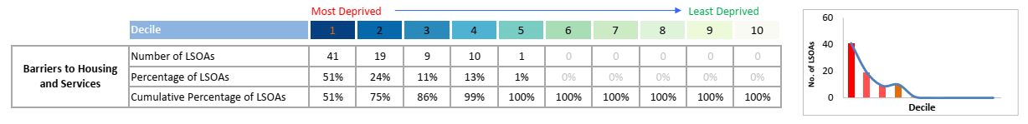
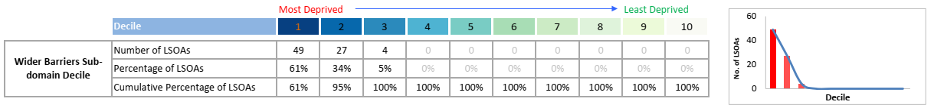
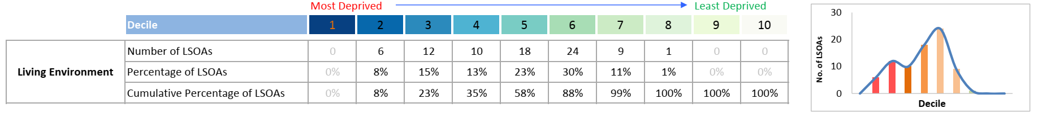
Built & Natural Environment - Deprivation
Slough is more deprived than the England average for barriers to housing and services in the 2019 indices of deprivation and is much more deprived than the average for wider barriers (i.e., overcrowding, homelessness, housing affordability). Slough is also more deprived than the England average for living environment (e.g., condition of home, air quality).
Notes:
Source: Indices of Deprivation, 2019.

Slide 40


Green spaces and air quality
Slough has 240 hectares of green space (7.4% of the borough, England: 2.2%).
98 hectares of this is public parks and gardens (3% of the borough, England: 0.8%).
However, Slough has higher than average concentrations of Benzene, Nitrogen Dioxide, Particulates and Sulphur Dioxide.
6.3% of mortality in Slough is attributable to particulate air pollution (England: 5.5%).
Notes:
Sources:
Green spaces: Ordnance Survey, 2017.
Air pollution concentrations: DEFRA, 2022.
Mortality attributable to air pollution: OHID, Fingertips Public Health Data, 2021.

Slide 41
Work & Labour Market
Built & natural environment
Education
Health & Wellbeing
Crime
Vulnerability
Income

Slide 42

Work & Labour Market – Economic activity
85.8% of Slough’s population aged 16-64 were economically active in the 2023 Annual Population Survey. This has increased from the 2021 census when it was 74.9%
Slough has a larger proportion of economically active residents (aged 16-64) than the South East and England.
Economic activity (aged 16-64, APS 2023) | Slough | South East | England
Economically active | 85.8% | 81.70% | 79.0%
Economically inactive | 14.2% | 18.30% | 21.0%
Notes:
Sources:
ONS annual population survey, 2023. The APS data applies only to those aged 16 to 64 (working age).
Census 2021.

Slide 43
Work & Labour Market – Unemployment & job density
Slough is more deprived than the South East average but less than the England average for employment in the 2019 indices of deprivation.
Slough has a larger proportion of people claiming unemployment benefit than the South East and England averages.
Slough has a higher job density than South East and England averages.
Percentage of working age residents (16-64) | Slough | South East | England
People aged 16+ claiming unemployment benefit (JSA & UC) | 5.6% | 3.0% | 4.0%
Young people aged 18-24 claiming unemployment benefit (JSA & UC) | 6.5% | 4.0% | 5.1%
Job density (Ratio of jobs to pop aged 16-64) | 0.82 | 0.76 | 0.78
Notes:
Sources:
Unemployment benefit: Nomis Labour Market Profile, May 2024.
Jobs density: ONS jobs density, 2022

Slide 44
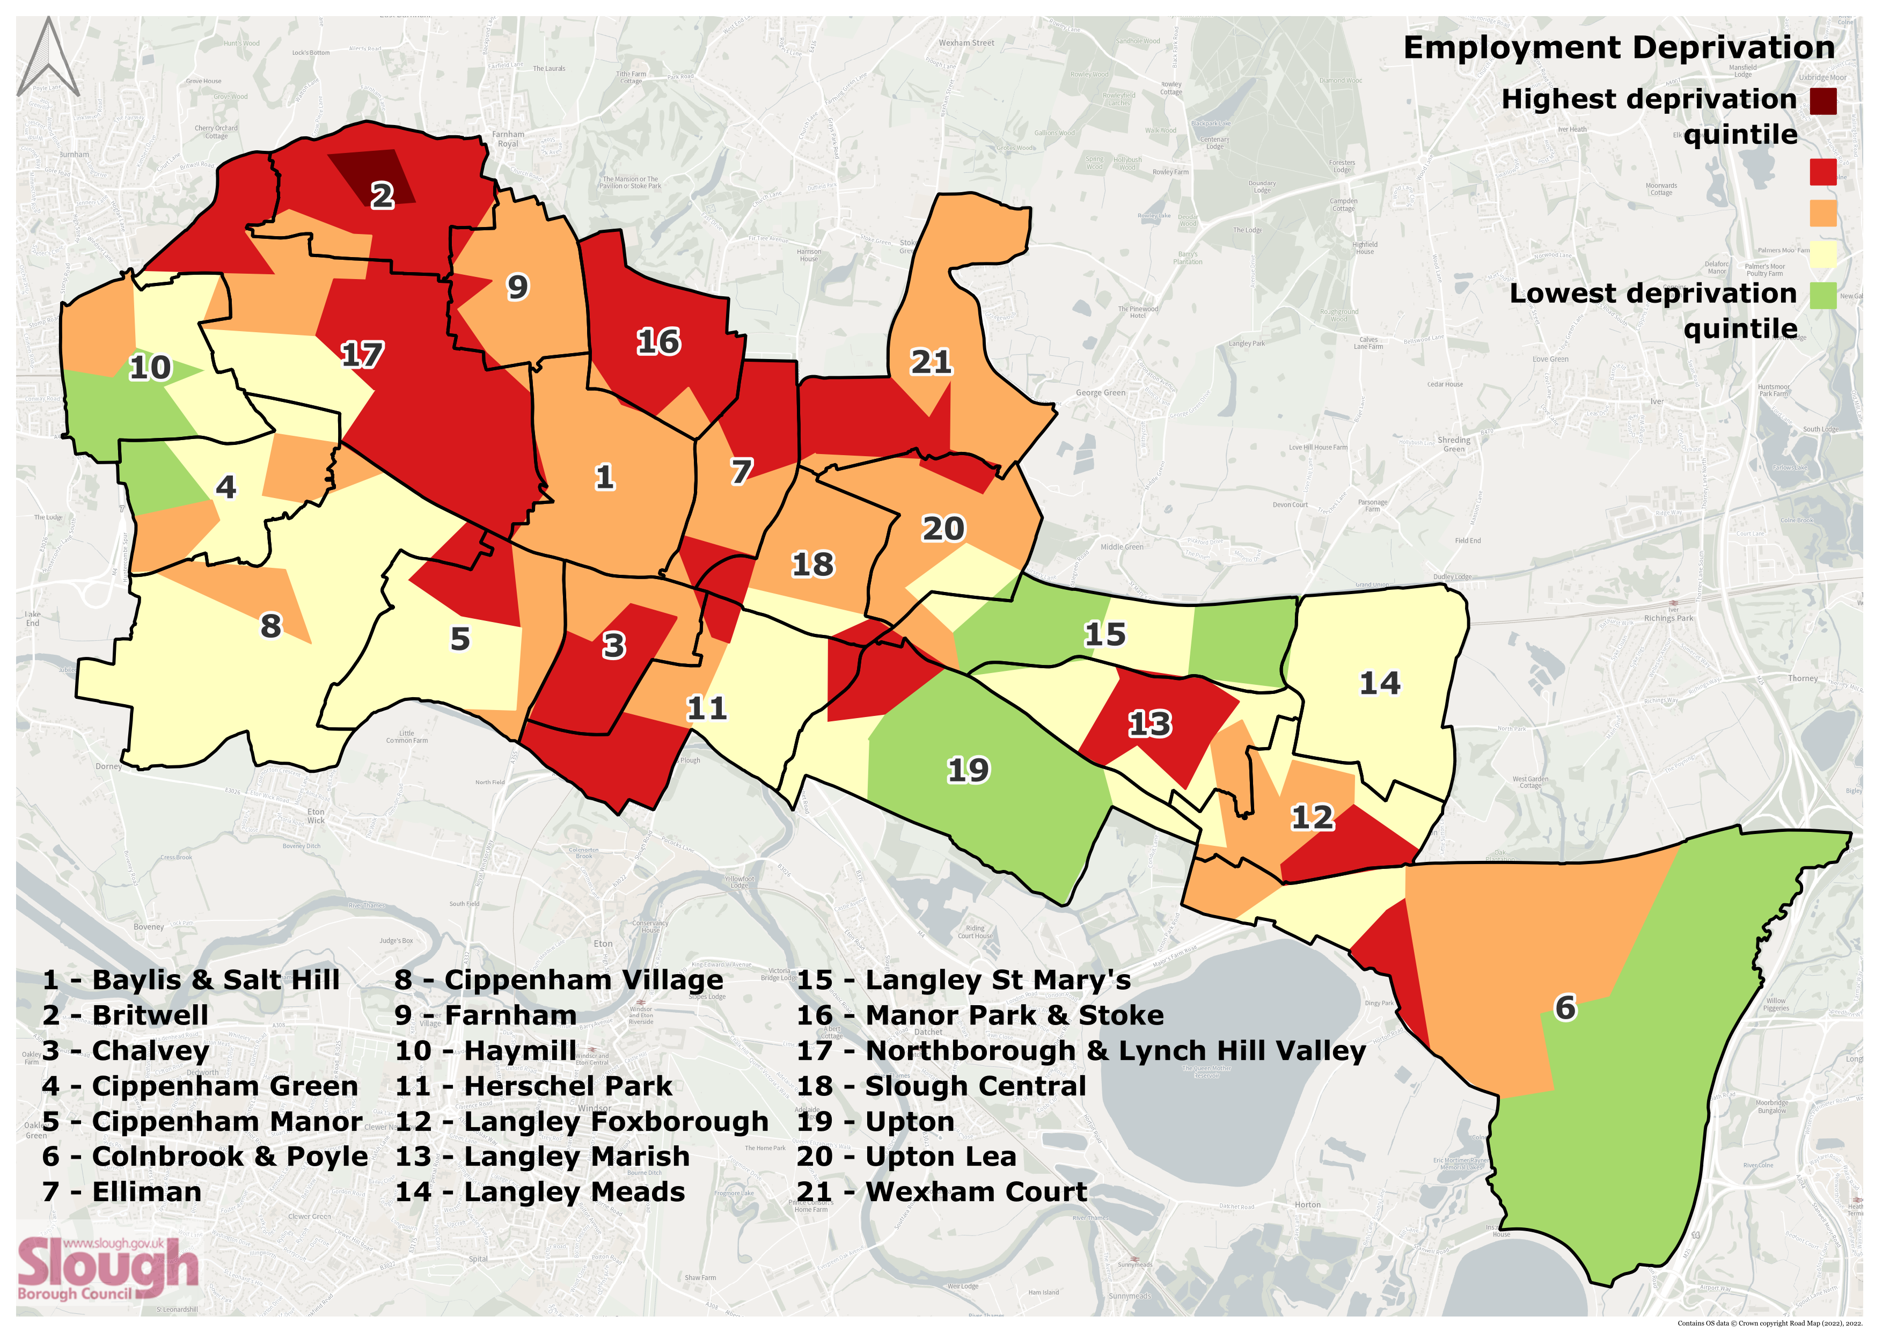
Work & Labour Market – Employment deprivation
This map shows employment deprivation across Slough from the 2019 Indices of Deprivation.
Red represents higher deprivation.
There is a particularly severe pocket of employment deprivation (dark red) in Britwell.
Notes:
Source: Indices of Deprivation, 2019.
The map uses Lower-tier Super Output Areas (LSOAs), which comprise between 400 and 1,200 households and have a usual resident population between 1,000 and 3,000 persons.

Slide 45
Work & Labour Market - Industry
Slough has larger proportions of workers in the transportation and storage industry and the information and communication industry than the South East and England.
Estimated number in employment | Slough
Transportation and storage | 12,000
Wholesale and retail trade; repair of motor vehicles and motorcycles | 12,000
Administrative and support service activities | 11,000
Information and communication | 9,000
Professional, scientific and technical activities | 8,000
Human health and social work activities | 7,000
Education | 6,000
Manufacturing | 6,000
Accommodation and food service activities | 3,500
Construction | 3,500
Notes:
Sources: BRES 2022.
This data only applies to those aged 16 or over and in employment. Employment includes employees, self-employed, and owners.
This data is the industry worked in by people that live in Slough. Please note, it does not tell us if residents work in these industries within Slough or travel to work outside of Slough. It also does not include people who work in Slough but live outside of Slough.
The data uses the UK Standard Industrial Classification (SIC), 2007.

Slide 46
Work & Labour Market - Occupation
Slough’s largest occupation classification is professional occupations, which aligns with the South East and England.
Estimated number in employment | Slough
Professional Occupations | 35,700
Elementary occupations | 15,400
Administrative and Secretarial Occupations | 13,600
Personal Service Occupations | 12,700
Sales and Customer Service Occupations | 12,100
Process, Plant and Machine Operatives | 10,900
Managers and Senior Officials | 10,000
Associate Prof & Tech Occupations | 8,600
Skilled Trades Occupations | 5,700
Notes:
Sources: Annual Population Survey, Dec 2023.
This data only applies to those aged 16 or over and in employment.
This data is the occupation worked in by people that live in Slough. Please note, it does not tell us if residents work in these occupations within Slough or travel to work outside of Slough. It also does not include people who work in Slough but live outside of Slough.
The data uses the Standard Occupational Classification (SOC), 2020.

Slide 47
Work & Labour Market – Vacancies
There were 36,273 total job postings in Slough from July to September 2023, of which 13,221 were unique (there may be multiple postings for one position). The average posting intensity for all occupations and companies was 3:1. An intensity higher than 2:1 indicates that more effort is being put into hiring for a position.
Top companies posting job adverts in Slough (July – September 2023) | Total Postings | Unique postings | Posting Intensity | Median Posting Duration (Days)
NHS | 4783 | 663 | 7:1 | 34
Academics | 895 | 301 | 3:1 | 36
Reed | 528 | 228 | 2:1 | 24
Adecco | 363 | 121 | 3:1 | 31
UCB | 315 | 104 | 3:1 | 35
Hays | 201 | 94 | 2:1 | 21
Pertemps Network | 241 | 93 | 3:1 | 28
Perfect Placement UK | 157 | 91 | 2:1 | 36
Mars Incorporated | 119 | 91 | 1:1 | 35
Ranstad | 271 | 75 | 4:1 | 37
Top occupations in job adverts in Slough (July – September 2023) | Total Postings | Unique postings | Posting Intensity | Median Duration (Days)
Sales related occupations n.e.c. | 1205 | 455 | 3:1 | 30
Other administrative occupations n.e.c. | 838 | 409 | 2:1 | 27
Nurses | 2888 | 339 | 9:1 | 34
Customer service occupations n.e.c. | 907 | 327 | 3:1 | 30
Teaching assistants | 735 | 297 | 2:1 | 28
Book-keepers, payroll managers, and wage clerks | 611 | 274 | 2:1 | 30
Marketing and sales directors | 496 | 272 | 2:1 | 33
Programmers and software development professionals | 416 | 229 | 2:1 | 34
Chartered and certified accountants | 510 | 226 | 2:1 | 29
Secondary education teaching professionals | 829 | 217 | 4:1 | 32
Notes:
Source: EMSI, October 2023 (data for July – September 2023) via Thames Valley Berkshire Quarterly Economic Briefing Q2 2023.
Posting Intensity: An intensity of 3:1 means that for every 3 postings, there was 1 unique job posting. A posting intensity of 2:1 indicates that they are putting average effort toward hiring for this position. A higher intensity indicates that more effort is being put in to hiring for a position.

Slide 48
Work & Labour Market – Productivity & business
 | Slough | Reading | London | UK
GVA per hour (£) | 62.9 | 48.6 | 48.1 | 36.3
Business start-ups per 10k population | 59.7 | 49.7 | 83.4 | 49.8
Business closures per 10k population | 67.2 | 61.3 | 83.8 | 51.1
Number of businesses per 10k population | 398 | 416.4 | 582.4 | 381.4
Change in number of businesses from 2021 to 2022 | -4.7 | -4.2 | -2.4 | -2.1
Slough had £62.90 GVA (Gross Value Added) per hour in 2021, the highest of all cities and large towns in the UK.
Slough had the 7th highest start-up rate of cities and large towns in the UK in 2022, with 59.7 business start-ups per 10k population.
Slough had the 7th highest number of businesses in 2022, with 398.0 business stock per 10k population. However, this was a decrease of 4.7% from 2021 (2021: 417.8).
Notes:
Source: Cities Outlook 2024 by Centre for Cities (January 2024), using data from the ONS.

Slide 49
Vulnerability
Built & natural environment
Education
Work & Labour Market
Health & Wellbeing
Crime
Income

Slide 50

Vulnerability – Family income, fuel poverty & loneliness
Slough has the largest proportions of children in relative and absolute low income families and pensioners in poverty in Berkshire and has larger proportions than the South East and England averages.
5,408 households in Slough were estimated to live in fuel poverty in 2022.
Slough scored as more vulnerable than the South East average but less than the England average on the Hardship Fund Vulnerability Index.
Slough has a higher rate of loneliness than the South East and England averages.
 | Slough | South East | England
Children in relative low-income families | 21.0% | 13.2% | 19.7%
Children in absolute low-income families | 17.4% | 10.7% | 15.6%
Pensioners in poverty (receiving pension credit) | 17.4% | 8.1% | 10.9%
Households living in fuel poverty | 10.0% | 9.7% | 13.1%
Hardship Fund Vulnerability Index score (higher score = more vulnerable) | 123 | 109 | 131
Loneliness Index score (lower score = more loneliness) | -1.4 | 0.9 | 0.1
Notes:
Sources:
Low-income families: DWP, 2023.
Pension credit: DWP, November 2023.
Fuel poverty: BEIS, 2022.
Hardship fund vulnerability index: British Red Cross, June 2020.
Loneliness index: ONS/NHS/Red Cross, 2019.
Hardship Vulnerability Fund index score: a higher score means more vulnerable.
Loneliness Index: based on the number of GP prescriptions for loneliness - a lower score means a higher rate of loneliness (i.e., more prescriptions).

Slide 51
Vulnerability – Universal Credit
Universal Credit | Slough | South East | England
Persons on Universal Credit (% of population aged 16-64) | 19.12% | 13.02% | 16.51%
Households on UC (% of households) | 28.54% | 15.99% | 20.54%
Households on UC: Family type: Single with dependent children | 10.59% | 5.71% | 7.19%
Households on UC: Carer entitlement | 2.56% | 2.05% | 2.58%
Households on UC: Child entitlement | 15.14% | 7.78% | 9.61%
Households on UC: Disabled child entitlement | 1.20% | 1.16% | 1.24%
Households on UC: Housing entitlement: Private rented | 10.98% | 4.90% | 5.91%
Households on UC: Housing entitlement: Social rented | 6.10% | 5.18% | 6.54%
Households on UC: Limited capability for work entitlement | 4.56% | 3.64% | 5.05%
Slough has larger proportions of universal credit than the South East and England for individuals aged 16-64 and for households.
Slough has larger proportions of UC than the South East for all entitlement categories in the table.
Slough has larger proportions of UC than England for the following categories:
Households with a single parent and dependent children
Households with child entitlement
Households with private rented housing entitlement
Notes:
Source: DWP, February 2024.

Slide 52
Vulnerability - Homelessness
Slough has a rising number of homeless households and people living in Temporary Accommodation.
There are key challenges around housing supply stock availability and affordability.
 | 2020-21 | 2021-22 | 2022-23 | 2023-24
Number of Homeless Reduction Act (HRA) approaches | 1745 | 1822 | 2086 | 2767
Preventions | 351 | 212 | 122 | 119
Number of Homelessness (relief case starts) | 369 | 419 | 502 | 768
% of final homeless decisions where the decision is Full Homeless Main Duty | 70% (92/132) | 73% (163/223) | 81% (146/181) | 91% (265/290)
Numbers currently in Temporary Accommodation | 414 | 462 | 676 (Estimate) | 846
Notes:
Source: SBC, July 2024.
Please note, the system and measures used in this table have changed since the previous version of this pack.

Slide 53
Vulnerability – Support
In 2023, Slough Foodbank provided 11,300 food parcels (21% increase from 2022). 7,171 food parcels were for adults (a 24% increase) and 4129 were for children (17% increase).
Slough Foodbank also provided 783 emergency fuel vouchers (30% increase from 2022) and 1,300 SIM cards.
In October 2023, Slough Foodbank and Citizens Advice launched a new service in Slough, with CA workers running sessions in Foodbank Distribution Centres to further help people in crisis, offering advice and information on benefits, debt, low income, discrimination at work, housing, homelessness and ill health. In Q4 of 2023, 54 clients were seen and 413 issues were identified. As a result of this service, an additional £23,132 income gain was achieved for clients.
In Dec 22 – Feb 23, Citizens Advice East Berkshire gave advice to 365 people:
62% were women
56% were disabled or have a long-term health condition
58% were from Black Asian and Minority Ethnic backgrounds
The top four issues were:
Housing – 29%
Benefits – 21%
Legal – 8%
Debt – 7%
Notes:
Sources:
Slough Foodbank, data for January – December 2023.
Citizens Advice East Berkshire, February 2024.

Slide 54
Vulnerability – Vulnerable children
Rate (per 10,000 0-17 year olds) | Slough | South East | England
Rate of Targeted Early Help | 148.5 | 122 | N/A
Rate of Children in Need | 353.2 | 335.6 | 342.7
Rate of children subject to Children in Need Plans | 110 | 105.8 | 91.2
Rate of children subject to Child Protection Plans | 46.3 | 42.9 | 43.2
Rate of Children Looked After | 46.3 | 57 | 71
Slough has higher than average rates of Children in Need and children receiving Targeted Early Help and Child Protection Plans.
Slough has a lower rate of Children Looked After than the England average and is similar to the South East average.
Notes:
Source: Slough Children First, May 2024.
Children in Need uses the wider DfE definition.

Slide 55
Vulnerability – Projected adult needs (aged 18-64)
PANSI projects increases in learning and physical disabilities and mental illness in Slough’s population aged 18-64 from 2023 to 2030.
Slough is projected to have larger percentage increases than the South East and England for several of the health issues and disabilities listed, especially longstanding health conditions caused by a stroke, diabetes, and hearing impairment.
Projected population change from 2023 to 2030 (Aged 18-64) | Slough 2023 | Slough 2030 | Slough Change | South East Change | England Change
Learning disability | 2,241 | 2,268 | +1.2% | +0.7% | +1.3%
Autism | 938 | 953 | +1.6% | +0.7% | +1.2%
Mobility impairment | 4,736 | 4,846 | +2.3% | 0% | +0.5%
Personal care disability (moderate and serious) | 4,183 | 4,324 | +3.4% | -0.2% | +0.2%
Longstanding health condition caused by a stroke | 261 | 284 | +8.8% | -0.3% | +0.2%
Diabetes | 2,880 | 3,036 | +5.4% | -0.2% | +0.3%
Visual impairment (serious) | 60 | 60 | 0% | +0.4% | +0.9%
Hearing impairment (moderate or serious) | 8,718 | 9,212 | +5.7% | +0.5% | +0.6%
Common mental health problems | 17,195 | 17,336 | +0.8% | +0.3% | +0.8%
At higher risk of alcohol related health problems | 3,938 | 4,063 | +3.2% | +0.5% | +1.1%
Dependent on drugs | 3,228 | 3,289 | +1.9% | +2.6% | +2.9%
Notes:
Source: PANSI, using data from 2018.
PANSI = Projecting Adult Needs and Service Information.
Please note that these projections are based on data from 2018 and underestimated Slough’s total population in 2021 by 7.6k compared to the 2021 Census.

Slide 56
Vulnerability – Projected adult needs (aged 65 and over)
POPPI projects increases in support needs, health issues, and disabilities in Slough’s population aged 65 and over from 2023 to 2030.
Slough is projected to have larger percentage increases than the South East and England for most of the health issues and disabilities listed.
Projected population change from 2023 to 2030 (Aged 65 and over) | Slough 2023 | Slough 2030 | Slough Change | South East Change | England Change
Learning disability | 347 | 404 | +16.4% | +15.2% | +15.1%
Autism | 156 | 185 | +18.6% | +15.9% | +15.6%
Mobility impairment | 2,875 | 3,393 | +18.0% | +17.0% | +16.3%
Need help with self care | 4,542 | 5,416 | +19.2% | +16.8% | +16.3%
Limiting long-term illness | 8,917 | 10,396 | +16.6% | +15.2% | +15.0%
Diabetes | 2,077 | 2,450 | +18.0% | +15.4% | +15.1%
Visual impairment (moderate or severe) | 1,412 | 1,671 | +18.3% | +14.8% | +14.7%
Hearing impairment (moderate or severe) | 10,957 | 12,834 | +17.1% | +17.7% | +17.1%
Depression | 1,411 | 1,667 | +18.1% | +15.4% | +15.2%
Dementia | 1,112 | 1,301 | +17.0% | +18.5% | +17.7%
Cardiovascular disease | 5,186 | 6,158 | +18.7% | +15.2% | +15.0%
Falls | 4,285 | 5,069 | +18.3% | +16.8% | +16.3%
Bladder/continence problems | 3,169 | 3,750 | +18.3% | +15.8% | +15.4%
Notes:
Source: POPPI, using data from 2018.
POPPI = Projecting Older People Population Information.
Please note that these projections are based on data from 2018 and underestimated Slough’s total population in 2021 by 7.6k compared to the 2021 Census.

Slide 57
Income
Built & natural environment
Education
Work & Labour Market
Health & Wellbeing
Crime
Vulnerability

Slide 58

Income – Weekly earnings
In 2023, there was a gap in gross weekly pay of £53.40 between Slough residents (£720.60) and all those who worked in Slough (£774). This gap has decreased from 2022, when it was £84.
Slough residents also earned £2.90 less per week than the South East average in 2023. This difference has also decreased from 2022, when Slough residents earned £27.80 less.
Earnings by Residence: Gross Weekly Pay (£) | Slough | South East | Great Britain
Full Time Earners | 720.6 | 723.5 | 682.6
Males | 733.9 | 781.9 | 728.3
Females | 698.6 | 646.1 | 628.8
Earnings by Place of Work: Gross Weekly Pay (£) | Slough | South East | Great Britain
Full Time Earners | 774.0 | 704.3 | 682.6
Males | 851.7 | 762.3 | 728.3
Females | 699.7 | 632.7 | 629.1
Earnings by Residence: Hourly Pay (£) (excl. overtime) | Slough | South East | Great Britain
Full Time Earners | 18.77 | 18.70 | 17.49
Male | 19.23 | 19.77 | 18.15
Females | 18.16 | 17.23 | 16.64
Earnings by Place of Work: Hourly Pay (£) (excl. overtime) | Slough | South East | Great Britain
Full Time Earners | 20.39 | 18.16 | 17.49
Male | 20.76 | 19.18 | 18.14
Females | 18.79 | 16.70 | 16.65
Notes:
Source: Nomis Labour Market Profile, December 2023 (data for 2023).

Slide 59
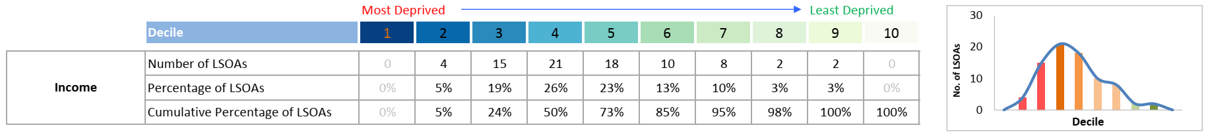
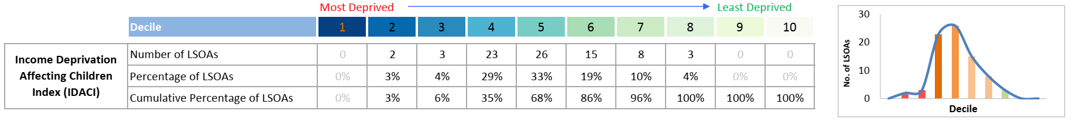
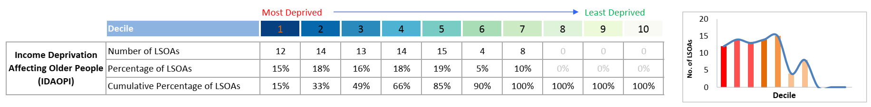
Income – Deprivation (1)
The charts below show where Slough’s neighbourhoods fall on the income domains of the 2019 Indices of Deprivation. For all three, most of Slough’s LSOAs fall below the national average.
For further data on children living in low-income families and pensioners in poverty, please see slide 45.
Notes:
Source: Indices of Deprivation, 2019.
LSOAs = Lower-tier Super Output Areas.

Slide 60
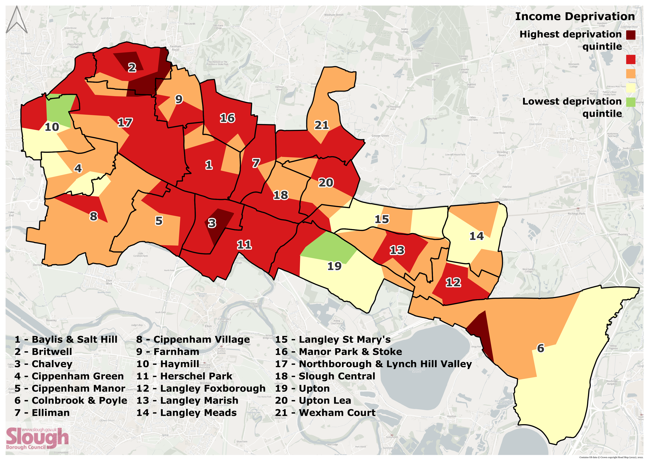
Income – Deprivation (2)
This map shows income deprivation across Slough from the 2019 Indices of Deprivation.
Red represents higher deprivation.
There are particularly severe pockets of income deprivation (dark red) in Britwell, Chalvey, and Colnbrook & Poyle.
Notes:
Source: Indices of Deprivation, 2019.
The map uses Lower-tier Super Output Areas (LSOAs), which comprise between 400 and 1,200 households and have a usual resident population between 1,000 and 3,000 persons.

Slide 61
Crime
Built & natural environment
Education
Work & Labour Market
Health & Wellbeing
Vulnerability
Income

Slide 62

Crime - Rates
Year ending December 2023
Crime | Slough Number | Slough Rate (per 1,000 pop) | TVP Rate (per 1,000 pop) | Eng & Wal Rate (per 1,000 pop)
Total recorded crime | 16,361 | 103 | 70 | 91
Violence against the person | 6,259 | 39 | 27 | 34
Sexual offences | 457 | 3 | 2 | 3
Theft offences | 5,433 | 34 | 24 | 30
Criminal damage and arson | 1,448 | 9 | 6 | 8
Drug offences | 550 | 3 | 2 | 3
Public order offences | 1,561 | 10 | 6 | 9
Notes:
Source: Crime in England & Wales, year ending December 2023 - Community Safety Partnership tables.
TVP = Thames Valley Police.

Slide 63
Education
Built & natural environment
Work & Labour Market
Health & Wellbeing
Crime
Vulnerability
Income

Slide 64


Education – EYFS
Prior to COVID, Slough was performing in the top quartile nationally for the proportion of children who achieved a good level of development at Early Years Foundation Stage (EYFS).
Slough fell below the national average in 2022 but improved in 2023 and is now above the national average in 2024.
Notes:
Source: DfE, 2024.
EYFS = Early Years Foundation Stage.

Slide 65
Education – Key Stage 2
Slough significantly exceeds the national average for attainment at KS2.
Notes:
Source: DfE, 2024.
This data is for children attending Slough schools (including children who live outside of Slough).

Slide 66
Education – Key Stage 4
Slough’s results continued to exceed national averages at KS4 in 2023.
Notes:
Source: DfE, 2023. 2024 data was not available at time of writing.
This data is for children attending Slough schools (including children who live outside of Slough).
Attainment 8 is a way of measuring how well pupils do in key stage 4, which they usually finish when they are 16 years old.
The 8 subjects which make up Attainment 8 include English and maths. Out of the remaining 6 subjects:
3 must come from qualifications that count towards the English Baccalaureate (EBacc), like sciences, language and history
3 qualifications can be either GCSE qualifications (including EBacc subjects) or technical awards from a list approved by the Department for Education
Each grade a pupil gets is assigned a point score from 9 (the highest) to 1 (the lowest). Each pupil’s Attainment 8 score is calculated by adding up the points for their 8 subjects, with English and maths counted twice. A school's Attainment 8 score is the average of all the scores of its eligible pupils.

Slide 67
Education – Post-16
93.8% of 16-17 year olds in Slough are in Education or Training (SE: 91.1%, Eng: 92.3%).
However, Slough is achieving lower grades (fewer average points per entry) at A-level or equivalent than the England average.
Notes:
Sources:
16-17 year olds in education or training: DfE, 2023. 2024 data was not available at the time of writing.
Average points per entry: DfE, 2024. 2024 data is provisional at time of writing.
Average points per entry: the average point score (APS) is calculated by dividing the total point score by the number of entries. This gives an indication of the average result achieved per qualification taken, which can be presented either in points or as a grade. This measure includes students who have entered for at least 1 qualification equivalent to at least 0.5 A levels, and applies to A level, applied general, academic (which combines the previous two cohorts), tech levels and level 2 vocational cohorts.
Applied General Qualifications are for students 16 - 19 years olds wishing to undertake a broad study of a specific vocational area. Applied General Qualifications include BTECs and OCR Cambridge Technicals.

Slide 68
Education - Qualifications
There has been a 50% increase in the number of Slough’s residents holding a level 4 qualification (degree equivalent) or above since 2011.
Slough is slightly below the national average in terms of levels of qualification – falling in the 41st percentile nationally.¹
Highest Qualification: Number of Slough Residents (Aged 16 or Over) | 2021 | 2011
No qualifications | 23,966 | 21,434
Level 1 and entry | 12,764 | 15,673
Level 2 | 14,336 | 14,256
Apprenticeship | 5,004 | 2,371
Level 3 | 16,181 | 10,790
Level 4 and above | 41,423 | 27,560
Other | 5,260 | 14,561
Notes:
Sources: Census 2021 and 2011.
The highest qualification data only applies to residents aged 16 and over.
¹This uses the highest level of qualification index score, which is a summary measure that can be used to compare how highly qualified population groups are. Slough’s index score is 2.38 compared to 2.45 for England.
Data Quality Info: Although the highest level of qualification is broadly comparable between 2011 and 2021, there are caveats. The categories remain the same as they were in 2011 and are derived in the same way, however the way the questions were structured and how the respondent was routed in the qualification questions changed substantially from 2011. These changes to the collection methodology mean that a reasonable proportion of respondents will have identified a different qualification level than they did in 2011 even though they still hold the same qualifications. Therefore, any change in qualification levels when compared with 2011 will be partly a result of the methodology changes and be partly indicative of real change. As such, the ONS advises interpreting these with caution, avoid drawing conclusions from the differences or using them to inform planning or evaluate policies.
Qualification levels:
No qualifications: no formal qualifications
Level 1: 1 to 4 GCSE passes (grade A* to C or grade 4 and above) and any other GCSEs at other grades, or equivalent qualifications
Level 2: five or more GCSE passes (grade A* to C or grade 4 and above) or equivalent qualifications
apprenticeships
Level 3: two or more A Levels or equivalent qualifications
Level 4 or above: Higher National Certificate, Higher National Diploma, Bachelor's degree, or post-graduate qualifications
Other qualifications of unknown level or equivalent unknown
For more information on equivalent qualifications, see https://www.ons.gov.uk/peoplepopulationandcommunity/educationandchildcare/bulletins/educationenglandandwales/census2021#measuring-the-data

Slide 69
Education - SEND
5,310 (15.4%) of children in Slough schools have a Special Educational Need or Disability.
Notes:
Source: DfE, 2024.
SEND: Special Educational Need or Disability

Slide 70
Education – EHC plans
Of the children with an EHC Plan, the most prevalent primary needs are:
38.9% are Autistic
18.9% have Speech, Language, and Communication needs
7.6% have Social, Emotional, and Mental Health needs
7.6% have Moderate Learning Difficulties
Notes:
Sources:
Percentage of new EHC Plans issued within 12 weeks: LAIT Tool, 2024. 2024 Slough data is provisional at the time of writing.
Most prevalent EHCP primary needs: DfE 2023-24.
National data was not available for 2023 and 2024.
EHC = Education, Health, and Care.

Slide 71
Education – SEN support & EHC plan attainment
Area | Measure | Slough | South East | England
EYFS​ | % of pupils w. SEN support: good level of development​ (2023/24) | 24.2% | 26.1% | 25.0%
EYFS​ | % of pupils w. EHC plan: good level of development​ (2023/24) | 6.9% | 4.8% | 3.9%
KS2​ | % of pupils w. SEN support: expected standard - Reading, Writing, Maths​ (2023/24) | 29.5% | 24.4% | 25.6%
KS2​ | % of pupils w. EHC plan: expected standard - Reading, Writing, Maths​ (2023/24) | 8.2% | 8.3% | 8.8%
KS4​ | & of pupils w. SEN support: Grade 5+ in English & Maths GCSE​ (2022/23) | 22.1% | 21.8% | 20.5%
KS4​ | & of pupils w. EHC plan: Grade 5+ in English & Maths GCSE​ (2022/23) | 7.7% | 6.8% | 6.8%
NEET​ | % of 16-17 year olds w. SEN support not participating in education, employment or training​ (2022/23) | 13.0% | 10.8% | 9.3%
NEET​ | % of 16-17 year olds w. EHC plan not participating in education, employment or training​ (2022/23) | 11.6% | 12.5% | 10.1%
Level 3​ | % of 19 year olds w. SEN support qualified to lv.3​ (2021/22) | 34.0% | 36.2% | 36.7%
Level 3​ | % of 19 year olds w. EHC plan qualified to lv.3​ (2021/22) | 9.8% | 14.6% | 14.0%
Notes:
Sources:
EYFS and KS2: DfE, 2024
KS4: DfE, 2023.
NEET: LG Inform 2022/23.
Level 3: LG Inform, 2021/22.

Slide 72
Sources
Data in this pack:
2021 Census
2011 Census
2019 Indices of Deprivation
ONS: People, population and community
OHID: Fingertips Public Health Data
NOMIS: Census & Labour Market
Community Safety Partnership Recorded Crime
Other useful sources:
Berkshire Observatory
Berkshire East JSNA
PHOF Wider Determinants of Health
Local Insight (login required – contact Strategic Insight Team)

