Slide 1
Slough Adult Autism Strategy
2024-2029

Slide 2
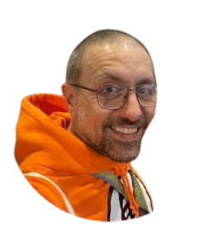
Hello and welcome!
Giuseppe Di Martino
LD and Autism Commissioner

Slide 3
Plan
The Council is writing a Plan to design the future of the Autism services in Slough.
We want Slough to become one of the first Autism-Friendly town and community in England.

Slide 4
Listening to residents
We have listened to what you had to say about your needs and priorities, and how to make Slough an Autism-friendly town
Your feedback have been grouped in 8 important areas; these are:

Slide 5
Independent living and support
Independent Living
This includes the co-production of dedicated initiatives with the autistic community (nothing about us without us), improved information in accessible format (e.g. video, simple language), improved awareness of autism in the community especially for fundamental services (e.g. housing maintenance support).
Support in the community
The creation of dedicated spaces where to access advocacy, information, and events that meet the needs of the autistic community (e.g. sensory needs). To increase awareness of autism in the wider population, peer-mentoring support and advice (Expert by experience)

Slide 6
Integration of services and transition to adulthood
Integration of Heath & Care Services
We need to work with health partners to improve waiting time for diagnosis, better training opportunities for health and Adult Social Care staff to support autistic needs in mainstream services (schools, hospitals), improved and accessible communication.
Transition and preparing for adulthood.
We need for a clearer pathway to adulthood. This should include early planning, timely referral, and improved communication between adult and children teams, and with carers.

Slide 7
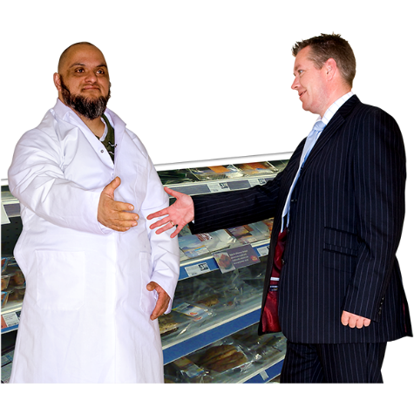
Employment and skills, and staying safe from abuse
Employment, skill development, training.
We need specific local programmes of skill development, mentoring opportunities (e.g. expert by experience), and resources to improve Autism awareness in the workplace and in education for all ages.
Stay safe and free from abuse.
We need improved awareness of Autism needs within the wider community, pathways to improve self-protection, self-advocacy. Better access to reporting, and appropriate support when abuse takes place.

Slide 8
Preventing loneliness and information sharing
Preventing loneliness and social isolation.
We feel the need for improved road safety to access the community, the creation of dedicated urban spaces in town suitable for autistic people, and dedicated community initiatives (e.g. special interests' groups) to promote socialisation and prevent isolation.
Communication and information sharing
It is an absolute priority to improve accessibility and availability of information in suitable formats (e.g. videos), as well as providing additional clarity on how to access communication and information about services (e.g. some people may not read, others may not be comfortable talking on the phone).

Slide 9
Actions
Partnership working
Autism Friendly Employer
Joint projects and initiatives that aim to improve services and support for autistic adults in Slough
Raise autism awareness as an employer to create more inclusive and supportive workplaces
Steering Group
Communication and Information
Co-chaired by autistic people, their families and carers to make sure we do what we say - together.
We will be guided by the steering group on how to address communication preferences
Autism Awareness
Quality Community Support
Development and delivery of Autism training for our workforce and the wider community.
Discharge processes, semi-independent accommodation, community initiatives, etc.

Slide 10
Actions part 2
Actions
Employment and skills
Safeguarding
Develop partnerships with employers, training providers, and community organisations
Safeguarding policy to recognise the specific needs of autistic people / Training / Improve awareness
Transition to adulthood
Health Inequalities
Active engagement with SEND and SCF – early planning
Identify barriers to develop autism-specific services – work with health colleagues to tackle waiting lists…
Preventing Loneliness
Dedicated Autism Day
Co-design and develop initiatives that promote socialisation and community engagement
A co-design and co-produced Slough yearly Autism event/festival to raise awareness in the community

Slide 11
Next Steps
Strategy Goes to Cabinet (26th February 2024)
Creation of Autism Steering Group – Co-chaired by CPN members and Autistic volunteers
Development of questionnaires specific for each themes and actions (with CPN)
Creation of working groups to deliver the actions in the Strategy

Slide 12
Any Questions?

