Slide 1


Update on Community Connectors 7 February 2024
Update on
Community Connectors
7th February 2024

Slide 2

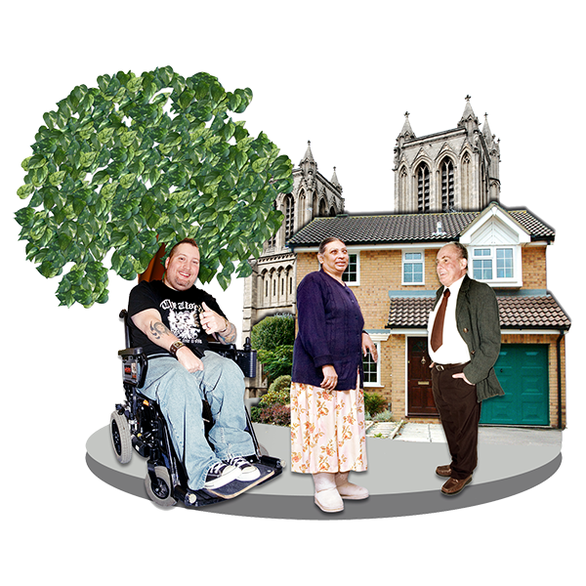
Background
Community Connector role is based on feedback from residents.
People wanted to know where they could find help in the community in a timely way.
We are working with Slough Council for Voluntary Service (SCVS) to develop how the service works.
As a new service we are constantly reviewing to understand what is working well and what needs changing

Slide 3

Progress
Community Connectors
408 Total of new Referrals for Oct-Dec 2023
347 WPH Discharge referrals
23 ASC referrals
19 Other agency referrals
15 Out of area referrals – although still signposted information during MaDE Week
13 Self referrals
6 SBC Customer Service
Notes:
56 in first qtr

Slide 4
Progress
Top Activities Connected to:
43% of referrals from SBC went to health/physical community activities
59% of referrals from Wexham Park Hospital went to health/physical community activities
29% of self referrals went to health/physical community activities

Slide 5
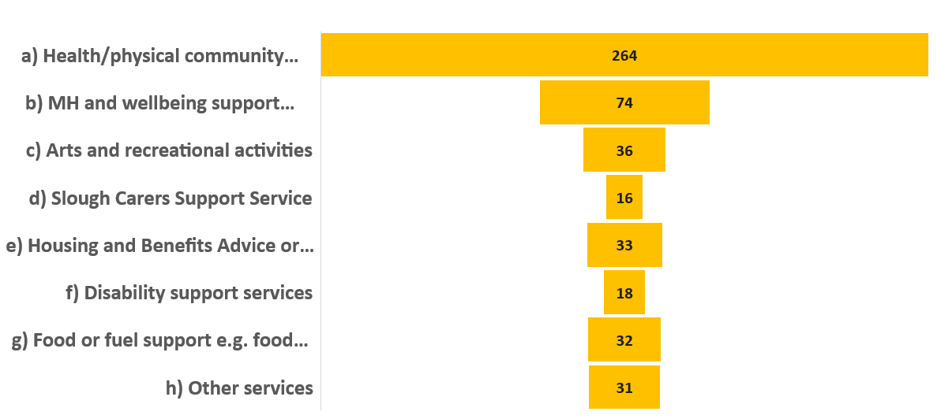
Total number of referrals

Slide 6
Community Directory of Services

Slide 7
Community Directory of Services
Top 5 Visited pages
1.Homepage
2.Submit an activity
3.Listings
4.Charities & Voluntary groups
5.Warm Spaces
Top 5 Visited Services
1.Information & Advice
2.Slough family services
3.Volunteering
4.Advice on staying healthy
5.Carers
Top 5 Visited Activities
1.Charities & Voluntary groups
2.Warm spaces
3.Sports, Leisure, parks and open spaces
4.Social Groups
5.Wellbeing

Slide 8

Any Questions?

